Slide 1
Computer Vision Basics
Geoff Hulten

Slide 2
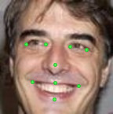
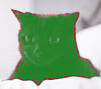
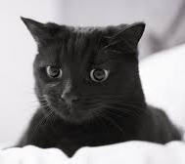
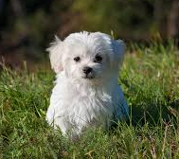
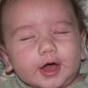

Predictions in Computer Vision
Classification
Localization
Segmentation
Important Points
Cat vs Not-Cat
Cat
Dog
Eye Closed
Eye Opened
Important Points
Eye vs Not Eye

Slide 3

Image Basics
Greyscale
8-bpp
Intensity
255 | 0 | 0
0 | 128 | 0
0 | 0 | 64
1.0 | 0 | 0
0 | 0.5 | 0
0 | 0 | .25
Encoding
Normalize
Red Channel
Color
Green Channel
Intensity
255 | 255 | 255
0 | 0 | 255
0 | 0 | 0
Blue Channel
255 | 0 | 0
255 | 0 | 0
255 | 255 | 0
1.0 | .21 | .21
.72 | .03 | .21
.72 | .72 | .01
Encoding
To Grey
255 | 0 | 0
0 | 128 | 0
0 | 0 | 64
Intensity = $\frac{0.21 ∗R+0.72∗G+0.07∗ B}{255}$

Slide 4

Indexing Image Data
x
0
1
2
X=0 Y=0 | X=1 Y=0 | X=2 Y=0 | X=0 Y=1 | X=1 Y=1 | X=2 Y=1 | X=0 Y=2 | X=1 Y=2 | X=2 Y=2
y
0
1.0 | 0 | 0
0 | 0.5 | 0
0 | 0 | .25
1
1.0 | 0 | 0 | 0 | 0.5 | 0 | 0 | 0 | 0.25
2
$$index=(y∗width)+x$$
from PIL import Image
# if path is in right format…
image = Image.open(<path>)
intensity = image.getpixel( ( 1, 1) ) / 255.0
from PIL import Image
# if path is in right format…
image = Image.open(<path>)
pixels = image.load()
intensity = pixels[1, 1] / 255.0

Slide 5

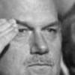
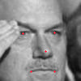
Blink Image Pipeline
Crop Region of Interest
Load
Grey
Localize
Not in Homework Framework
1.0 | 0 | 0
0 | 0.5 | 0
0 | 0 | .25
2.3 | -.5 | -.5
-.5 | .87 | -.5
-.5 | -.5 | .16
Normalize Size 24x24
24x24
Intensity Array
24x24
Normalized Array

Slide 6
Very Basic Image Features
Define the Region
Select the Property
Select the Conversion
Intensity
Response to
Gradient
Wavelets
Whole Image
Grids
Regions of Interest
Relative to Points of Interest
Average
Min/Max
Histograms

Slide 7
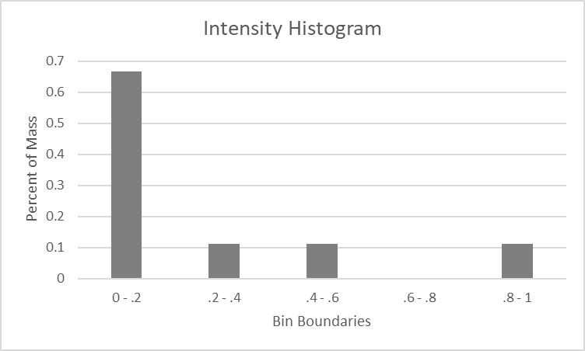
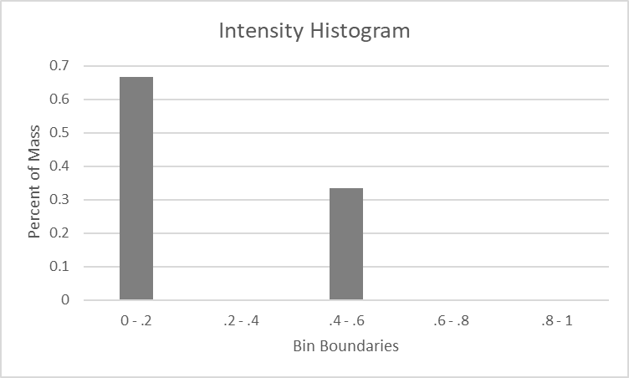
Intensity Features
Possible Features:
Average: 0.194
Max: 1.0
Min: 0.0
Region = Whole Image
Property = Intensity
1.0 | 0 | 0
0 | 0.5 | 0
0 | 0 | .25
Hist0-.2: .666
Hist.2-.4: .111
Hist.4-.6: .111
Hist.6-.8: 0
Hist.8-1:.111
Possible Features:
Average: 0.166
Max: 0.5
Min: 0.0
Region = Middle Column
Property = Intensity
1.0 | 0 | 0
0 | 0.5 | 0
0 | 0 | .25
Hist0-.2: .666
Hist.2-.4: 0
Hist.4-.6: .333
Hist.6-.8: 0
Hist.8-1: 0

Slide 8
Selecting Regions
Whole Image
Regular Grid
Region of Interest
Using Localization
8 Intensity
Features
32 Intensity
Features
8 Intensity
Features
24 Intensity
Features
Combinations
Feature selection:
By region
By feature
By feature type
72 Intensity
Features

Slide 9
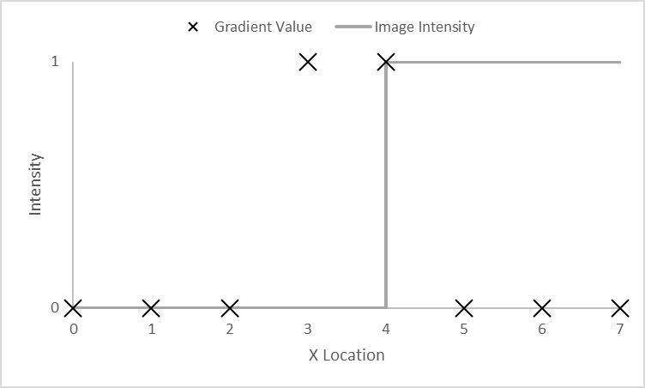
Gradients
$$Gradient\left(X\right)=Intensity\left(x+1\right)−Intensity(x−1)$$
Image
X-Gradient
Y-Gradient
Image
X-Gradient
Y-Gradient

Slide 10
Features from Gradients
Whole Image
Regular Grid
Region of Interest
Using Localization
16 Gradient
Features
64 Gradient
Features
16 Gradient
Features
48 Gradient
Features
Possible Features:
AverageX: 0.194
MaxX: 1.0
MinX: 0.0
AverageY: 0.23
MaxY: 0.4
MinY: 0.1
Combinations
HistX0-.2: .666
HistX.2-.4: .111
HistX.4-.6: .111
HistX.6-.8: 0
HistX.8-1:.111
HistY0-.2: .2
HistY.2-.4: 0
HistY.4-.6: .2
HistY.6-.8: 0
HistY.8-1:.6
144 Gradient
Features

Slide 11
Convolutions
3x3 Filter
0 | 0 | 0
-1 | 0 | 1
0 | 0 | 0
Response
0 | 0 | 0 | 0 | 0
0 | 1 | 1 | 0 | 0
0 | 1 | 1 | 0 | 0
0 | 1 | 1 | 0 | 0
0 | 1 | 1 | 0 | 0
0 | 0 | 0 | 0 | 0
Convolve
Intensity Data
0 | 0 | 1 | 1 | 1
0 | 0 | 1 | 1 | 1
0 | 0 | 1 | 1 | 1
0 | 0 | 1 | 1 | 1
0 | 0 | 1 | 1 | 1
0 | 0 | 1 | 1 | 1

Slide 12
Sobel Edge Detection
Simple X Gradient
Sobel X Gradient
0 | 0 | 0
-1 | 0 | 1
0 | 0 | 0
-1 | 0 | 1
-2 | 0 | 2
-1 | 0 | 1
Simple Y Gradient
Sobel Y Gradient
0 | 1 | 0
0 | 0 | 0
0 | -1 | 0
1 | 2 | 1
0 | 0 | 0
-1 | -2 | -1

Slide 13
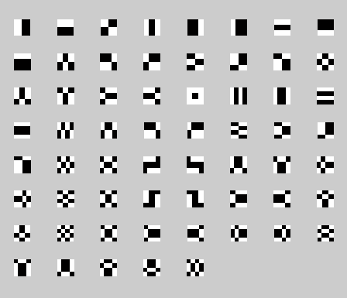
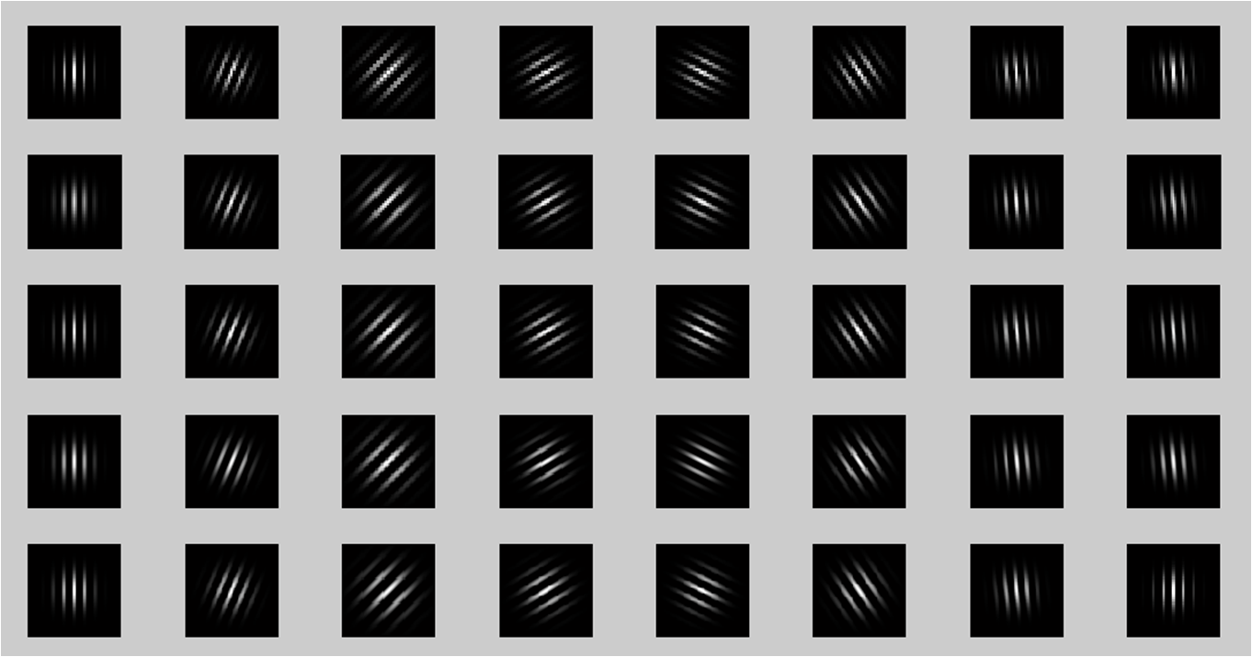
Wavelet Features
Gabor Wavelets
Haar Wavelets
Neural Networks?

Slide 14
Summary of Basics of Computer Vision
Basic Predictions
Classification
Localization
Segmentation
Preprocessing Pipeline
Normalize: color, size
Localize & crop
Convert to intensity, normalize
Construct Features With
Region
Intensity or response
Statistics
Almost all modern computer vision done with neural networks – we’ll get there…

